Slide 1
Software Testing
Some of the slides taken from:
Software Engineering, Ian Sommerville, 9th Edition
Prof. Richard McKenna’s lecture on Test Driven Development at SBU

Slide 2
Topics covered
Why do software projects fail?
Development testing
Test-driven development
Release testing
User testing

Slide 3
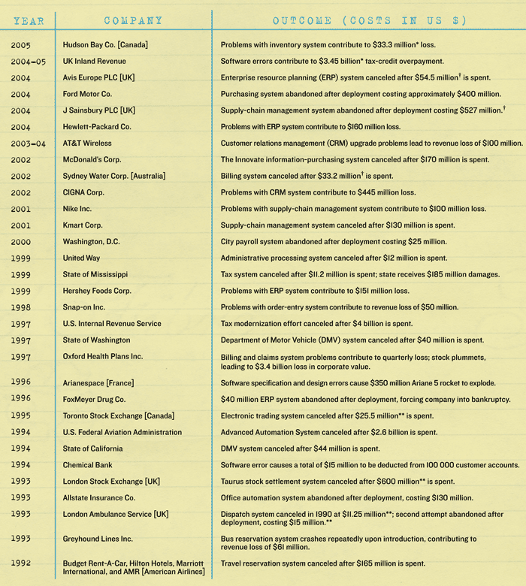
Reading Assignment
Why Software Fails:
https://spectrum.ieee.org/computing/software/why-software-fails
Software Hall of Shame ->

Slide 4
Why do projects fail so often?
Among the most common factors:
Unrealistic or unarticulated project goals
Inaccurate estimates of needed resources
Badly defined system requirements
Poor reporting of the project’s status
Unmanaged risks
Poor communication among customers, developers, and users
Use of immature technology
Inability to handle the project’s complexity
Sloppy development practices
Poor project management
Stakeholder politics
Commercial pressures

Slide 5
Man-hours
Labor is sometimes measured in man-hours, man-months, or man-years.
Example: Doom3 took 5 years and more than 100 man-years of labor to develop
Company Spokesman: "It will be ready when it's done"
Why not double the size of the team and halve the lead time (concept date to release date)?

Slide 6
Man-hours: The Mythical Man-Month
Assume that a software program might take one expert programmer a year to develop = 12 man-months
Market pressures might be such that we want to get the program finished in a month, rather than a year
1 programmer * 12 months = 12 programmers * 1 month?
When you throw additional programmers at a project that is late, you are likely to make it more late!
Remove promised-but-not-yet-completed features, rather than multiplying workers bees.
Also, at least one team member must have detailed knowledge of the entire system (all the modules).

Slide 7
Program testing
Testing is intended to show that a program does what it is intended to do and to discover program defects before it is put into use.
When you test software, you execute a program using artificial data.
You check the results of the test run for errors, anomalies or information about the program’s non-functional attributes.
Can reveal the presence of errors NOT their absence.
Testing is part of a more general verification and validation process, which also includes static validation techniques.

Slide 8
Testing process goals
Validation testing
To demonstrate to the developer and the system customer that the software meets its requirements
A successful test shows that the system operates as intended.
You expect the system to perform correctly using a given set of test cases that reflect the system’s expected use.
Defect testing
To discover faults or defects in the software where its behaviour is incorrect or not in conformance with its specification
A successful test is a test that makes the system perform incorrectly and so exposes a defect in the system.
The test cases are designed to expose defects.
The test cases in defect testing can be deliberately obscure and need not reflect how the system is normally used.

Slide 9
An input-output model of program testing

Slide 10
Verification vs validation
Verification: "Are we building the product right”.
The software should conform to its specification.
Validation: "Are we building the right product”.
The software should do what the user really requires.

Slide 11
Inspections and testing
Software inspections is concerned with analysis of the static system representation to discover problems (static verification)
May be supplement by tool-based document and code analysis.
Software testing is concerned with exercising and observing product behaviour (dynamic verification)
The system is executed with test data and its operational behaviour is observed.

Slide 12
Inspections and testing

Slide 13
Software inspections
These involve people examining the source representation with the aim of discovering anomalies and defects.
Inspections not require execution of a system so may be used before implementation.
They may be applied to any representation of the system (requirements, design,configuration data, test data, etc.).
They have been shown to be an effective technique for discovering program errors.

Slide 14
Inspections and testing
Inspections and testing are complementary and not opposing verification techniques.
Both should be used during the V & V process.
Inspections can check conformance with a specification but not conformance with the customer’s real requirements.
Inspections cannot check non-functional characteristics such as performance, usability, etc.

Slide 15
A model of the software testing process

Slide 16
Stages of testing
Development testing, where the system is tested during development to discover bugs and defects.
Release testing, where a separate testing team test a complete version of the system before it is released to users.
User testing, where users or potential users of a system test the system in their own environment.

Slide 17
General testing guidelines
Choose inputs that force the system to generate all error messages
Design inputs that cause input buffers to overflow
Repeat the same input or series of inputs numerous times
Force invalid outputs to be generated
Force computation results to be too large or too small.

Slide 18
Development testing

Slide 19
Development testing
Development testing includes all testing activities that are carried out by the team developing the system.
Unit testing
Individual program units or object classes are tested.
Unit testing should focus on testing the functionality of objects or methods.
Component testing
Several individual units are integrated to create composite components.
Component testing should focus on testing component interfaces.
System testing
Some or all of the components in a system are integrated and the system is tested as a whole.
System testing should focus on testing component interactions.

Slide 20
Unit testing
Unit testing is the process of testing individual components in isolation.
It is a defect testing process.
Units may be:
Individual functions or methods within an object
Object classes with several attributes and methods
Composite components with defined interfaces used to access their functionality.

Slide 21
Object class testing
Complete test coverage of a class involves
Testing all operations associated with an object
Setting and interrogating all object attributes
Exercising the object in all possible states.
Inheritance makes it more difficult to design object class tests as the information to be tested is not localised.

Slide 22
Automated testing
Whenever possible, unit testing should be automated so that tests are run and checked without manual intervention.
In automated unit testing, you make use of a test automation framework (such as JUnit) to write and run your program tests.
Unit testing frameworks provide generic test classes that you extend to create specific test cases.
They can then run all of the tests that you have implemented and report on the success of otherwise of the tests.

Slide 23
Automated test components
A setup part, where you initialize the system with the test case, namely the inputs and expected outputs.
A call part, where you call the object or method to be tested.
An assertion part where you compare the result of the call with the expected result. If the assertion evaluates to true, the test has been successful if false, then it has failed.

Slide 24
Boundary Conditions
A boundary condition is an input that is “one away” from producing a different behavior in the program code
Such checks catch 2 common types of errors:
Logical errors, in which a path to handle a special case presented by a boundary condition is omitted
Failure to check for conditionals that may cause the underlying language or hardware system to raise an exception (ex: arithmetic overflow)

Slide 25
Partition testing
Partition testing, where you identify groups of inputs that have common characteristics and should be processed in the same way.
Input data and output results often fall into different classes where all members of a class are related.
Each of these classes is an equivalence partition or domain where the program behaves in an equivalent way for each class member.
Test cases should be chosen from each partition.

Slide 26
Equivalence partitioning

Slide 27
Equivalence partitions

Slide 28
Testing paths through specification
Path-completeness:
Test cases are generated to exercise each path through a program.
May be insufficient to catch all errors.
Can be used effectively only for a program fragment that contains a reasonable number of paths to test.
Examine the method specifications (preconditions) & all paths through method to generate unique test cases for testing.
/* REQUIRES: x >= 0 && y >= 10 */
public static int calc(int x, int y) { ... }
Translate paths to test cases:
x = 0, y = 10 (x == 0 && y == 10)
x = 5, y = 10 (x > 0 && y == 10)
x = 0, y = 15 (x == 0 && y > 10)
x = 5, y = 15 (x > 0 && y > 10)
x = -1, y = 10 (x < 0 && y == 10)
x = -1, y = 15 (x < 0 && y > 10)
x = -1, y = 9 (x < 9 && y < 10)
x = 0, y = 9 (x == 0 && y < 10)
x = 1, y = 9 (x > 0 && y < 10)

Slide 29
Component testing
Software components are often composite components that are made up of several interacting objects.
For example, in the weather station system, the reconfiguration component includes objects that deal with each aspect of the reconfiguration.
You access the functionality of these objects through the defined component interface.
Testing composite components should therefore focus on showing that the component interface behaves according to its specification.
You can assume that unit tests on the individual objects within the component have been completed.

Slide 30
Interface testing
Objectives are to detect faults due to interface errors or invalid assumptions about interfaces.
Interface types
Parameter interfaces Data passed from one method or procedure to another.
Shared memory interfaces Block of memory is shared between procedures or functions.
Procedural interfaces Sub-system encapsulates a set of procedures to be called by other sub-systems.
Message passing interfaces Sub-systems request services from other sub-systems

Slide 31
Interface testing guidelines
Design tests so that parameters to a called procedure are at the extreme ends of their ranges.
Always test pointer parameters with null pointers.
Design tests which cause the component to fail.
Use stress testing in message passing systems.
In shared memory systems, vary the order in which components are activated.

Slide 32
System testing
System testing during development involves integrating components to create a version of the system and then testing the integrated system.
The focus in system testing is testing the interactions between components.
System testing checks that components are compatible, interact correctly and transfer the right data at the right time across their interfaces.
System testing tests the emergent behavior of a system.

Slide 33
System and component testing
During system testing, reusable components that have been separately developed and off-the-shelf systems may be integrated with newly developed components.
The complete system is then tested.
Components developed by different team members or sub-teams may be integrated at this stage.
System testing is a collective rather than an individual process.
In some companies, system testing may involve a separate testing team with no involvement from designers and programmers.

Slide 34
Black-box testing
It is the best place to start when attempting to test a program thoroughly
Test cases based on program’s specification, not on its implementation (see the homework grading sheets)
Test cases are not affected by:
Invalid assumptions made by the programmer
Implementation changes
Use same test cases even after program structures has changed
Test cases can be generated by an “independent” agent, unfamiliar with the implementation.
Test cases should cover all paths (not all cases) through the specification, including exceptions.

Slide 35
Test-driven development

Slide 36
Test-driven development
Test-driven development (TDD) is an approach to program development in which you inter-leave testing and code development.
Tests are written before code and ‘passing’ the tests is the critical driver of development.
You develop code incrementally, along with a test for that increment. You don’t move on to the next increment until the code that you have developed passes its test.
TDD was introduced as part of agile methods such as Extreme Programming. However, it can also be used in plan-driven development processes.

Slide 37
Test-driven development

Slide 38
TDD process activities
Start by identifying the increment of functionality that is required. This should normally be small and implementable in a few lines of code.
Write a test for this functionality and implement this as an automated test.
Run the test, along with all other tests that have been implemented. Initially, you have not implemented the functionality so the new test will fail.
Implement the functionality and re-run the test.
Once all tests run successfully, you move on to implementing the next chunk of functionality.

Slide 39
Benefits of test-driven development
Code coverage
Every code segment that you write has at least one associated test so all code written has at least one test.
Regression testing
A regression test suite is developed incrementally as a program is developed.
Simplified debugging
When a test fails, it should be obvious where the problem lies. The newly written code needs to be checked and modified.
System documentation
The tests themselves are a form of documentation that describe what the code should be doing.

Slide 40
Regression testing
Regression testing is testing the system to check that changes have not ‘broken’ previously working code.
In a manual testing process, regression testing is expensive but, with automated testing, it is simple and straightforward. All tests are rerun every time a change is made to the program.
Tests must run ‘successfully’ before the change is committed.

Slide 41
Release testing

Slide 42
Release testing
Release testing is the process of testing a particular release of a system that is intended for use outside of the development team.
The primary goal of the release testing process is to convince the supplier of the system that it is good enough for use.
Release testing, therefore, has to show that the system delivers its specified functionality, performance and dependability, and that it does not fail during normal use.
Release testing is usually a black-box testing process where tests are only derived from the system specification.

Slide 43
Release testing and system testing
Release testing is a form of system testing.
Important differences:
A separate team that has not been involved in the system development, should be responsible for release testing.
System testing by the development team should focus on discovering bugs in the system (defect testing). The objective of release testing is to check that the system meets its requirements and is good enough for external use (validation testing).

Slide 44
Performance testing
Part of release testing may involve testing the emergent properties of a system, such as performance and reliability.
Tests should reflect the profile of use of the system.
Performance tests usually involve planning a series of tests where the load is steadily increased until the system performance becomes unacceptable.
Stress testing is a form of performance testing where the system is deliberately overloaded to test its failure behaviour.

Slide 45
User testing

Slide 46
User testing
User or customer testing is a stage in the testing process in which users or customers provide input and advice on system testing.
User testing is essential, even when comprehensive system and release testing have been carried out.
The reason for this is that influences from the user’s working environment have a major effect on the reliability, performance, usability and robustness of a system. These cannot be replicated in a testing environment.

Slide 47
Types of user testing
Alpha testing
Users of the software work with the development team to test the software at the developer’s site.
Beta testing
A release of the software is made available to users to allow them to experiment and to raise problems that they discover with the system developers.
Acceptance testing
Customers test a system to decide whether or not it is ready to be accepted from the system developers and deployed in the customer environment. Primarily for custom systems.

Slide 48
The acceptance testing process

Slide 49
Stages in the acceptance testing process
Define acceptance criteria
Plan acceptance testing
Derive acceptance tests
Run acceptance tests
Negotiate test results
Reject/accept system

Slide 50
JUnit

Slide 51
JUnit
Unit-test framework for Java programs.
open source software
hosted on SourceForge: http://junit.sourceforge.net/javadoc
Moved to http://junit.org (for JUnit 4 and later)
not in the standard JDK:
import junit.framework.*;
//for JUnit 3.8 and earlier
import org.junit.*; //for JUnit 4 and later
Associate a Test class with each unit
one or more classes

Slide 52
JUnit
The test class has a set of test methods
public void testX()
where X is the method to be tested
The test methods use “assertions” to perform the tests, ex:
Assert.assertEquals(x,y)
Assert.assertTrue(c)
Assert.assertSame(obj1, obj2)

Slide 53
Building unit tests with JUnit
Initialize any instance variables necessary for testing in the test object
Define tests for emptiness, equality, boundary conditions, ...
Define test suites, if necessary, to group tests.
Use Assert methods to perform tests

Slide 54
JUnit 3.8 vs. 4
JUnit 4: all test methods are annotated with @Test.
Unlike JUnit3 tests, you do not need to prefix the method name with "test“.
JUnit 4 does not have the test classes extend junit.framework.TestCase (directly or indirectly).
Usually, tests with JUnit4 do not need to extend anything (which is good, since Java does not support multiple inheritance).

Slide 55
JUNIT tutorials with example
Test-Driven Development with Junit:
https://www.youtube.com/watch?v=2Ekty7t621k
Junit NetBeans Example:
https://examples.javacodegeeks.com/core-java/junit/junit-netbeans-example/

Slide 56
Apache JMeter

